Slide 1
Indigenous Art of Australia

Slide 2
Content Warning:
This presentation contains the images and names of people who have passed away.

Slide 3
Indigenous Australian Art

Slide 4
Indigenous Australian Art

Slide 5
Rock art

Slide 6
Rock art

Slide 7
Rock art

Slide 8
Rock art

Slide 9
Let’s look at some examples of Rock art.
See if you notice anything missing

Slide 17
What was Missing?

Slide 18
What was Missing?

Slide 19
Before Painting

Slide 20
Hermannsburg

Slide 21
Albert Namatjira

Slide 24
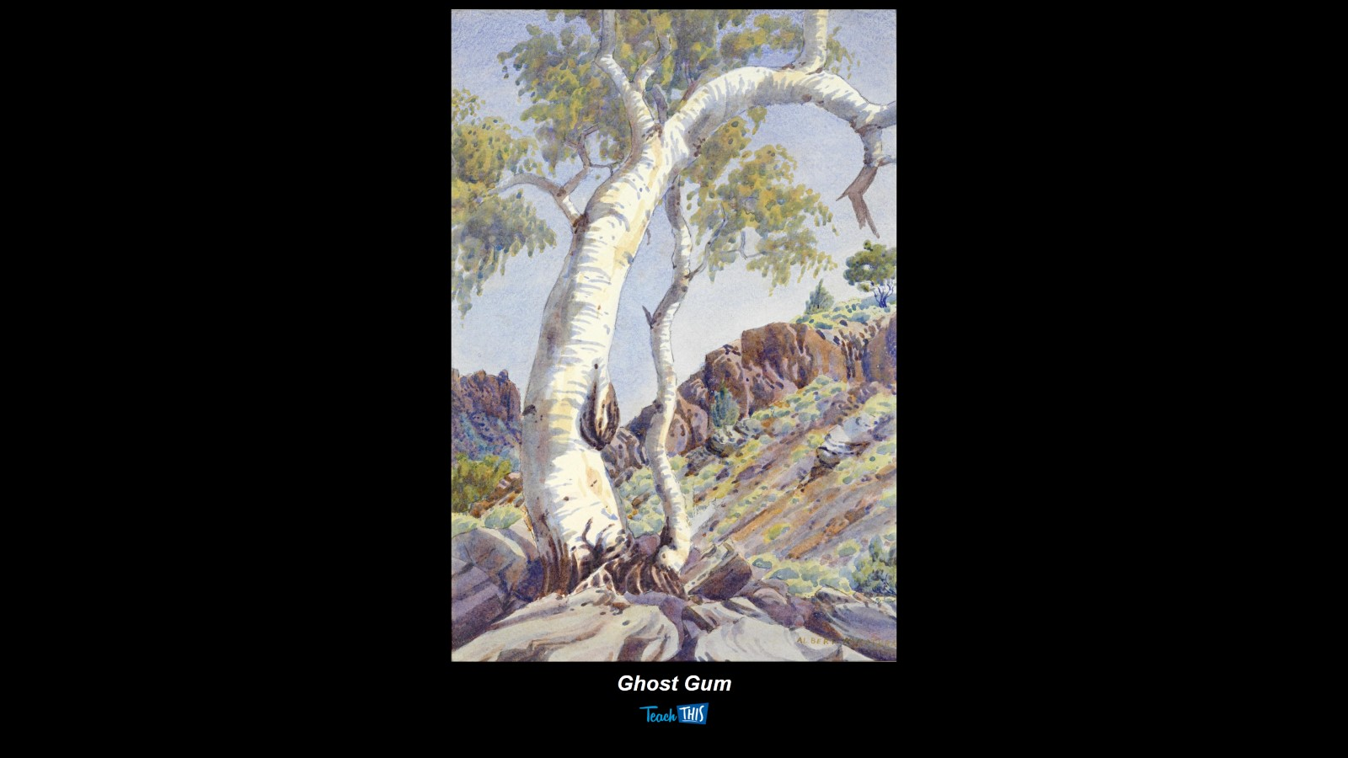

Slide 26
Papunya Tula

Slide 27
Dot Painting

Slide 30
Combining Influences

Slide 32
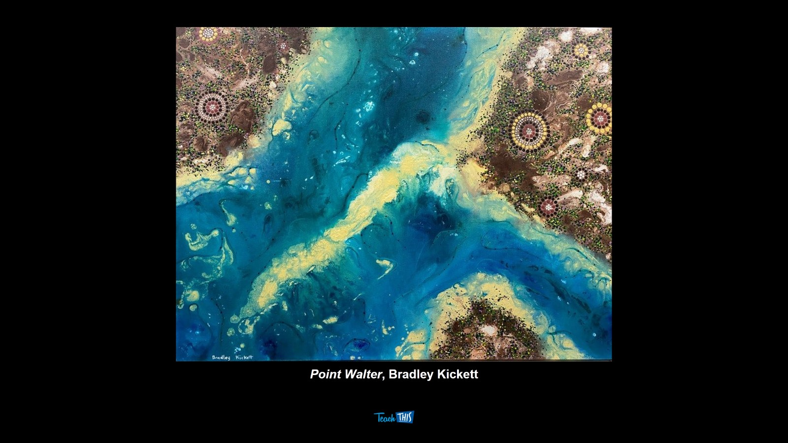

Slide 34
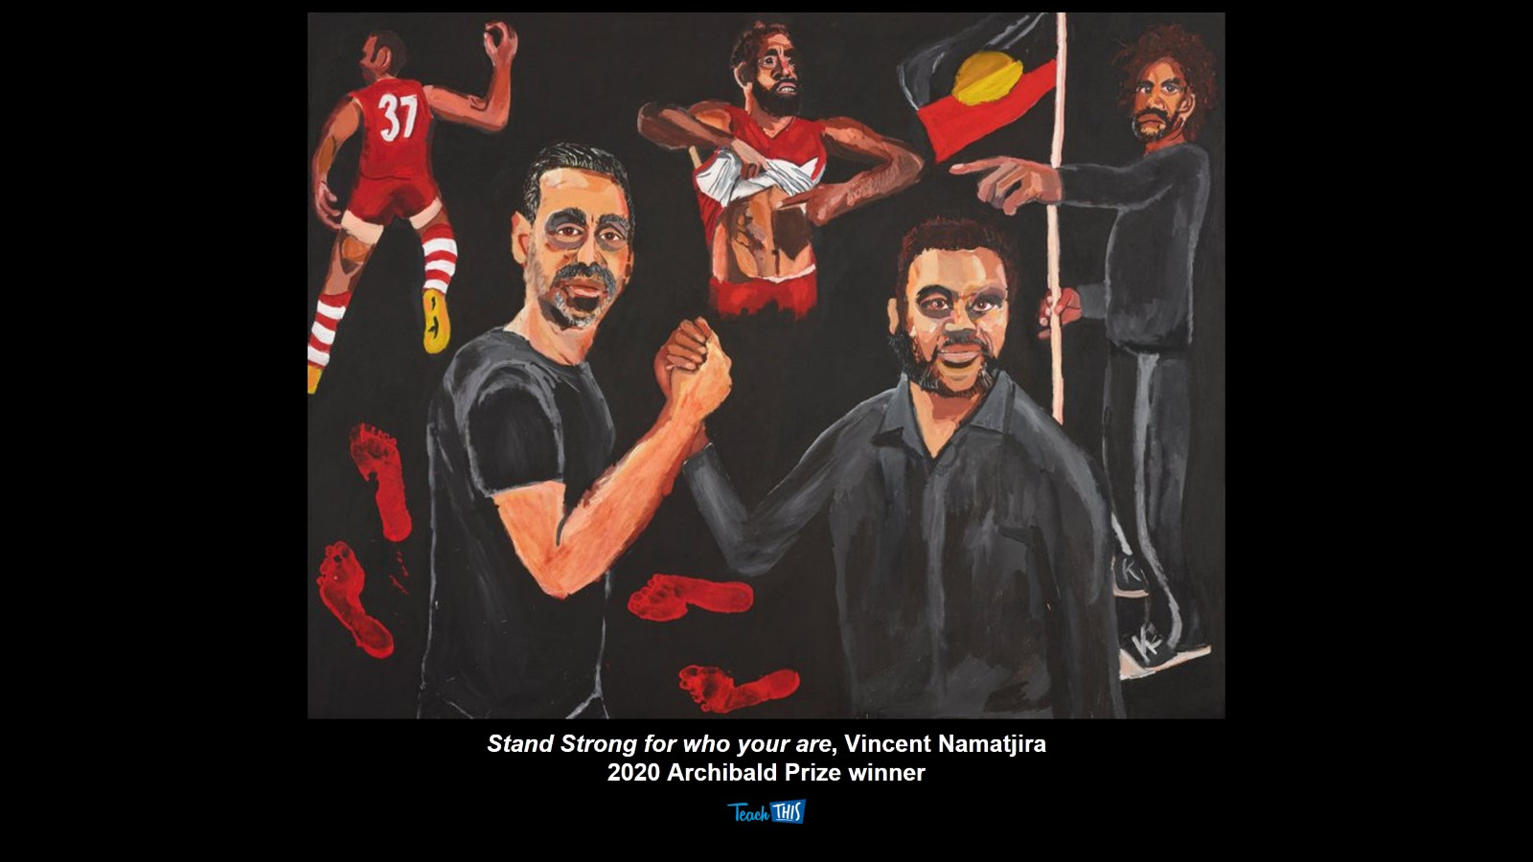

Slide 38
Review

Slide 39
What to do Next

